Slide 1
Describing Assorted LEGOs
Benjamin Hill

Slide 2
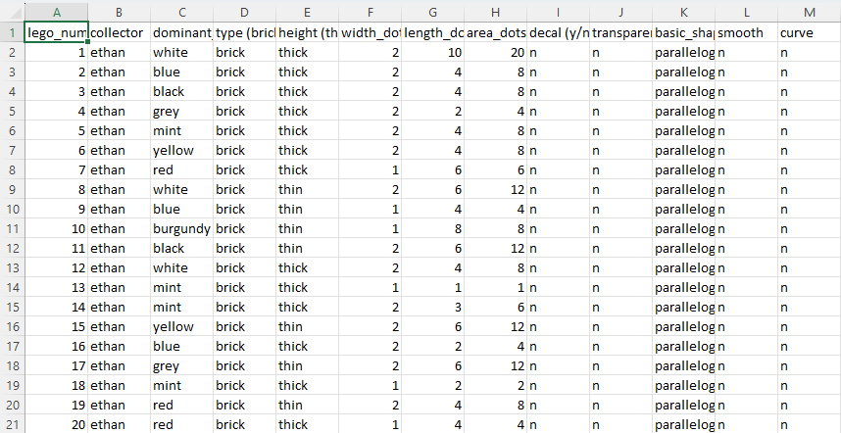
The intent here is to visualize a collection of LEGO pieces using graphs instead of images. The variables recorded include the order in which they were recorded, the color of the piece, whether it is a brick or not, whether it is a tall or short piece, its width and length and area in units of studs, whether or not it has decal or is transparent or smooth or curved, as well as its basic geometric shape.

Slide 3
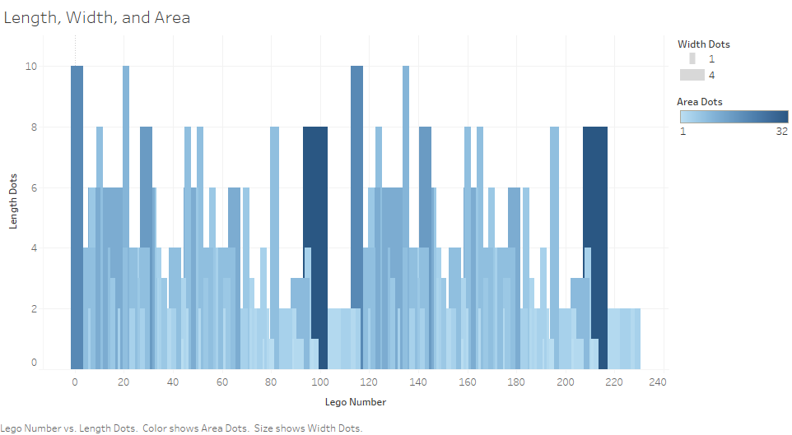
This chart shows piece length by the length of the bar, width by the width of the bar, and area by how darkly blue it is. It makes for an interesting visualization of the physical characteristics of the pieces in the set.

Slide 4
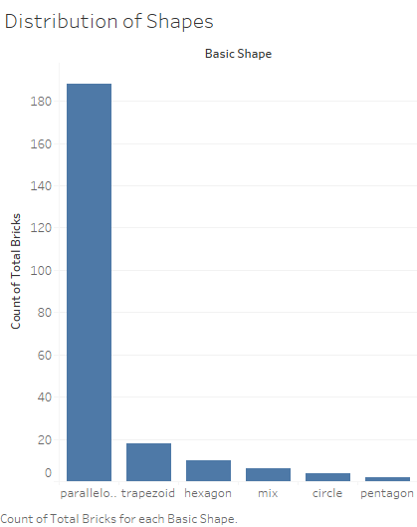
This histogram shows the frequency of each basic geometric shape. Clearly the most common shape is rectangular, recorded here as a parallelogram.

Slide 5
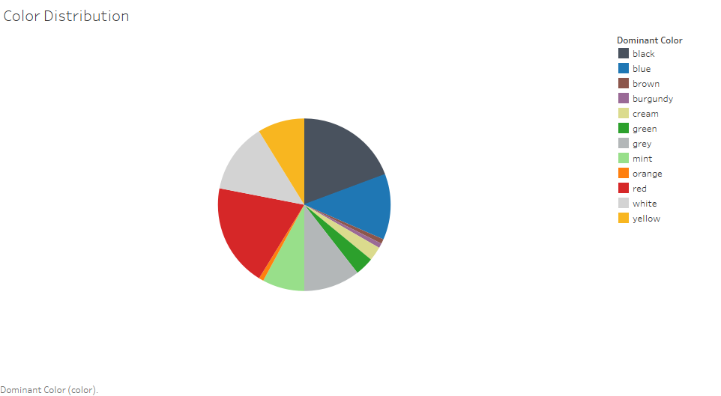
This chart displays the distribution of colors among the pieces. It is easy to understand, and there is a simple charm to the visualization.

Slide 6
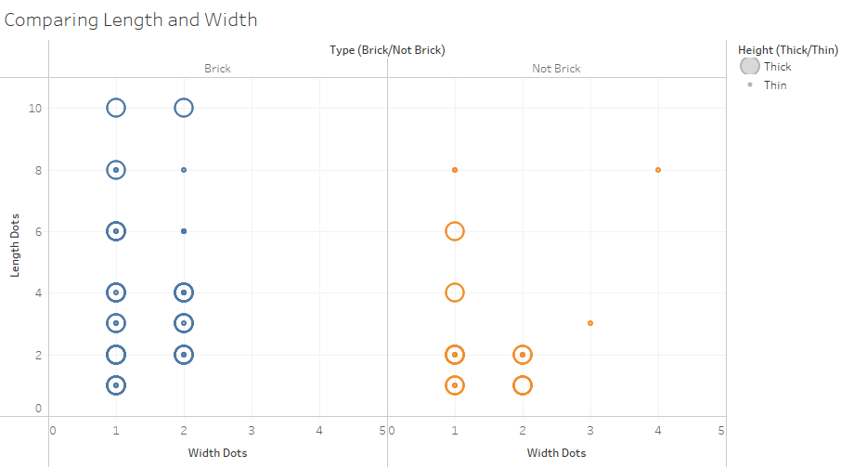
This chart compares length with width, along with comparing bricks with other types of pieces, and accounting for height. Notice that bricks in this set never exceed two studs in width.

